Slide 1
Arithmetic Operations on Digital Images

Slide 2
Arithmetic operations on Images
Arithmetic operations addition, subtraction, division, and multiplication which is performed pixel by pixel between two images or among many images

Slide 3
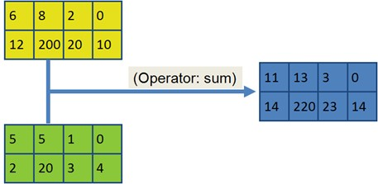
Addition operation
which is also called pixel addition. addition operator add two images in pixel by pixel fashion .matlab coding is given below
coding :
>>ima1=imread(‘image1.tif’)
>>ima2-imread(‘image2.tif’);
>>sum=ima1+ima2;

Slide 4
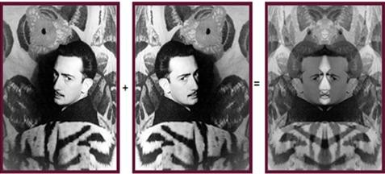
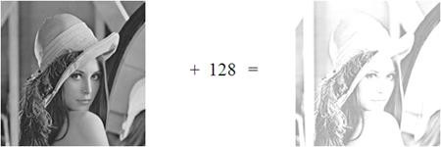
addition can also done using in-build matlab command
>>imadd(ima1,ima2);
any integer value can be added to an image matrix

Slide 5
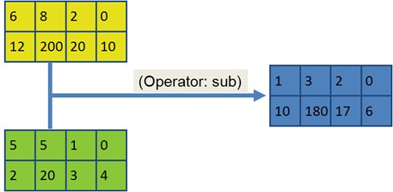
Subtraction operation
which is also called pixel subtraction. subtraction operator subtract two images in pixel by pixel fashion .matlab coding is given below
coding :
>>ima1=imread(‘image1.tif’)
>>ima2-imread(‘image2.tif’);
>>sub=ima1-ima2;

Slide 6
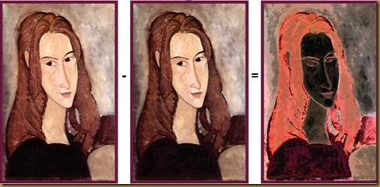
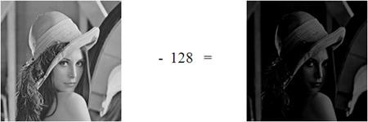
subtraction can also done using in-build matlab command
>>imsubtract(ima1,ima2);
any integer value can be subtracted from an image matrix

Slide 7
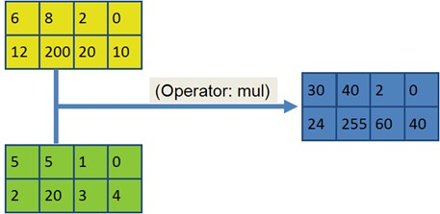
Multiplication operation
which is also called pixel multiplication. multiplication operator multiply two images in pixel by pixel fashion .matlab coding is given below
coding :
>>ima1=imread(‘image1.tif’)
>>ima2-imread(‘image2.tif’);
>>mul=ima1.*ima2;
dot(.) operator used to perform pixel wise operation

Slide 8
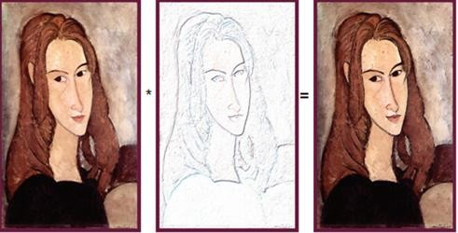
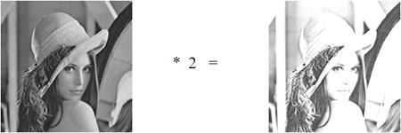
multiplication can also done using in-build matlab command
>>immultiply(ima1,ima2);
any integer value can multiply an image matrix

Slide 9
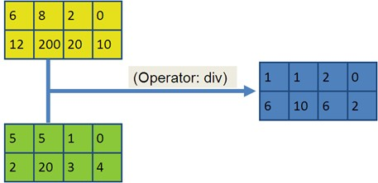
Division operation
which is also called pixel division.Division operator divide one image by other in pixel by pixel fashion .matlab coding is given below coding :
>>ima1=imread(‘image1.tif’)
>>ima2-imread(‘image2.tif’);
>>mul=ima1./ima2;
dot(.) operator used to perform pixel wise operation.

Slide 10
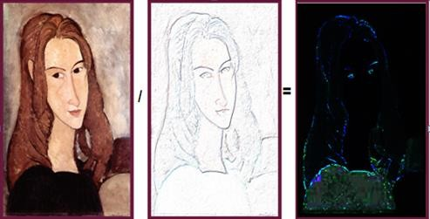
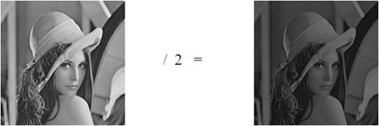
division can also done using inbuild matlab command
>>imdivide(ima1,ima2);
any integer value can divide an image matrix

